Slide 1
IRDL: An IR Definition Language for SSA Compilers
Gökay Gülsoy 270201072

Slide 2
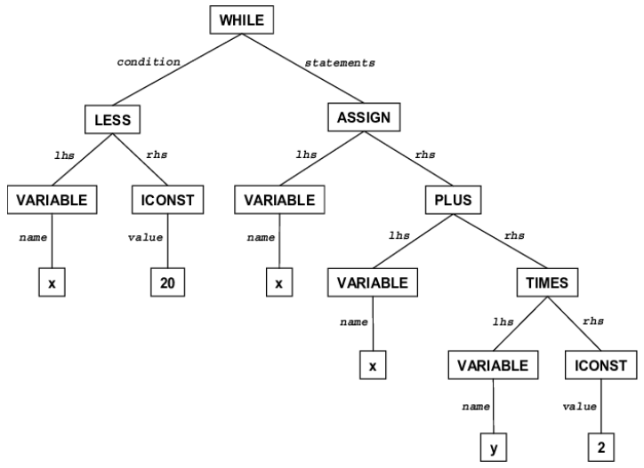
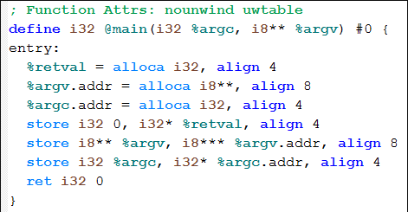
IR Design for Compilers
Developers generally use general-purpose programming languages to design IRs. As a result, IR implementations are verbose and manual modifications are expensive.
While compilers relied historically on a few slowly evolving IRs, domain specific optimizations and specialized hardware motivate compilers to use and evolve many IRs.

Slide 3
What is IRDL and Why it exists ?
Domain-specific language to define IRs, and it facilitates the implementation of SSA-based IRs.
It is capable of expressing 28 domain-specific IRs developed as a part of LLVM’s MLIR project while only rarely falling back to IRDL’s support for generic C++ extensions.
Aim is to enable concise and explicit specification of IRs and provide foundations for developing effective tooling to automate compiler construction process.

Slide 4
Need for IR design Languages
LLVM, as a compiler infrastructure, has not only its user-facing LLVM IR but additionally uses various internal ones that are typically not visible to its users. Some of them are SelectionDAG, MachineInst, and MCInst.
All of these IRs are deeply embedded into their respective compilers. Hence modifications require detailed compiler-specific knowledge, and even specialists are very hesitant to evolve existing IRs.
While there exists approaches for generating parts of compiler (parsers, backends, code-generators, etc.), we lack a solution that streamlines the design of IRs themselves.

Slide 5
General Properties of IRDL
MLIR does not provide predefined set of operations but relies on the concept of extensibility, with few built-in constructs leaving most of the IR customizable.
Operations,types, and attributes are grouped into dialects, similar to namespaces or modular libraries. Each dialect sits at a abstraction level. For example, Linalg dialect in MLIR models linear algebra operations on either tensor or buffer operands.
func @conorm(%p: !cmath.complex<!f32>, %q: !cmath.complex<!f32>) -> !f32 %norm_p = cmath.norm(%p) : !f32
%norme_q = cmath.norm(%q) : !f32
%pq = std.mulf %norm_p, % norm_q : !f32
return %pq : !f32

Slide 6
Self-Contained IRDL specification
Dialect cmath {
Alias !FloatType = !AnyOf<!f32,!f64>
Type complex {
Parameters (elementType: !FloatType)
Summary “A complex number”
}
Operation mul {
ConstraintVar (!T: !complex<FloatType>)
Operands (lhs: !T, rhs: !T)
Results (res: !T)
Format “$lhs, $rhs: $T.elementType”
Summary “Multiply two complex numbers”
}
Operation norm {
ConstraintVar (!T: !FloatType)
Operands(c: !complex<!T>)
Results (res: !T)
Format “$c: $T”
Summary “norm of complex number”
}
}

Slide 7
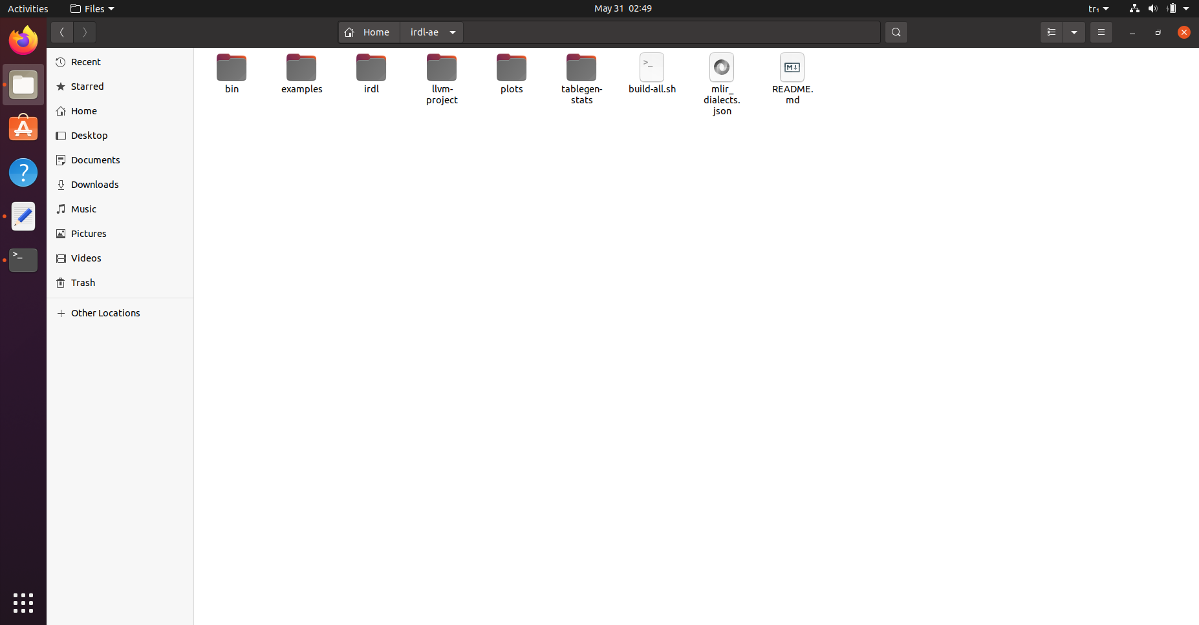
Reproduction of Artifact
General layout of the project

Slide 8
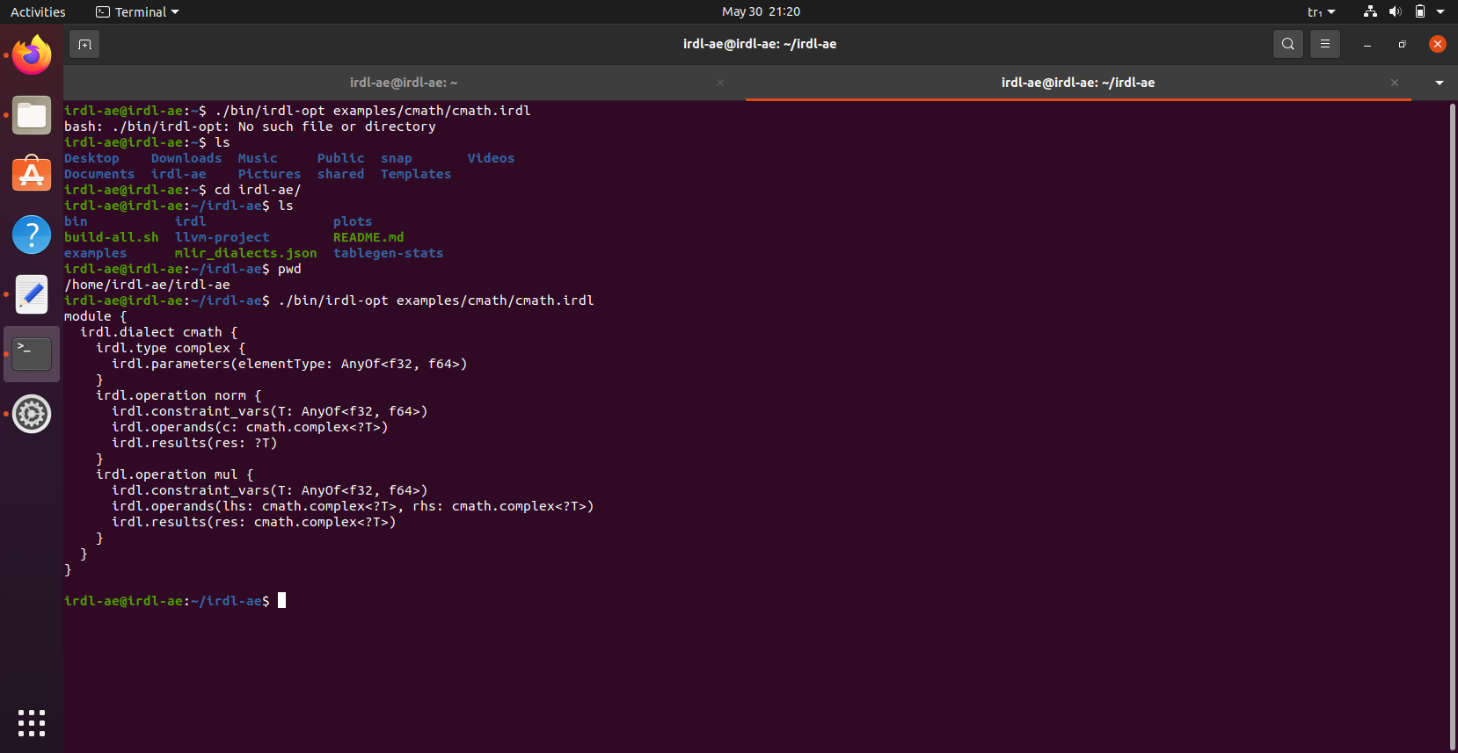
Reproduction of Artifact
Parsing cmath module with irdl-opt

Slide 9
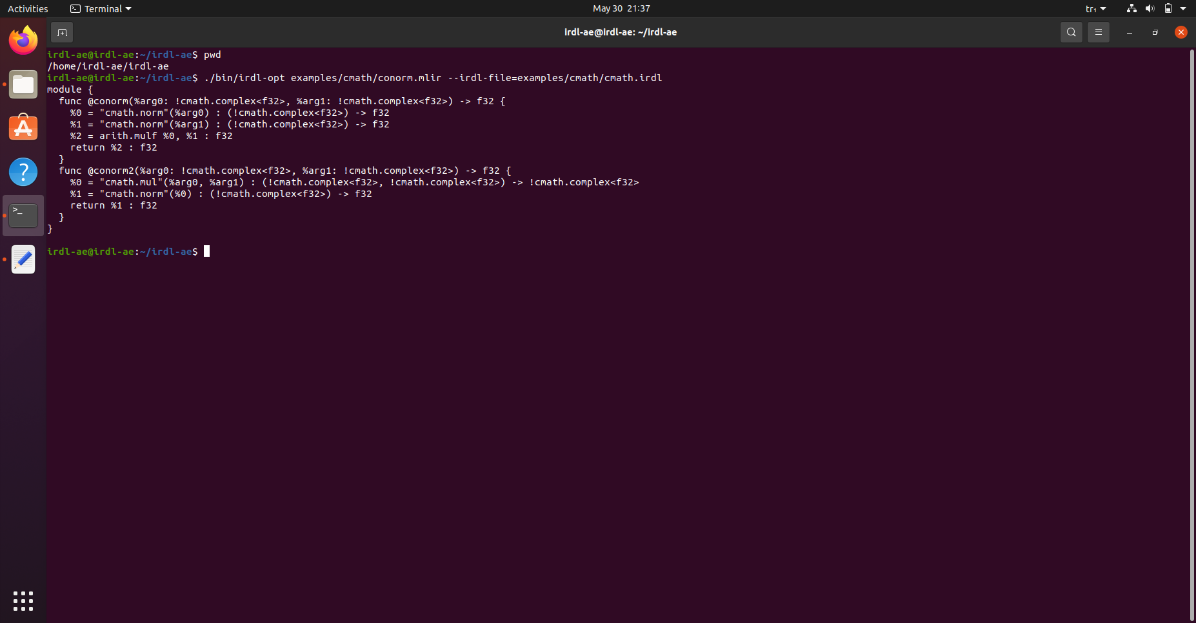
Reproduction of Artifact
Registering cmath dialect and parsing the conorm.mlir example

Slide 10
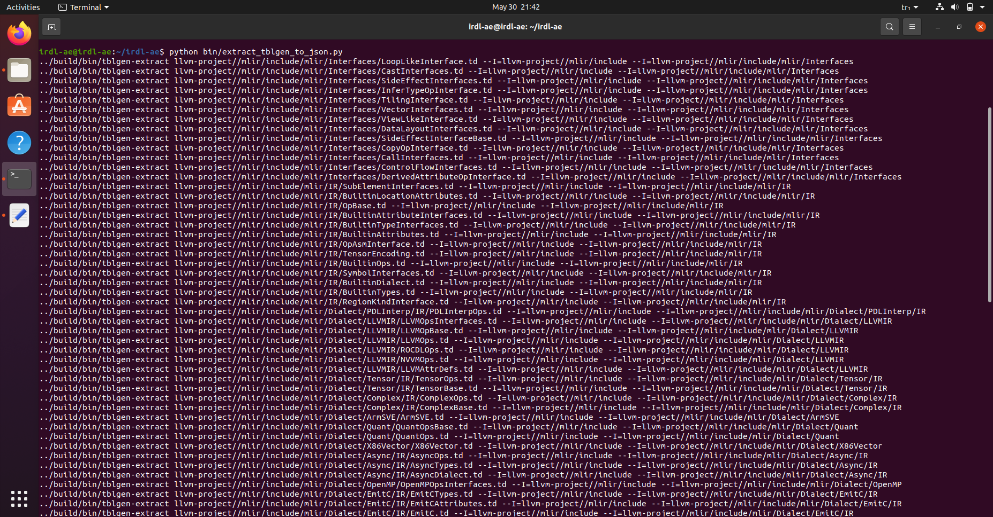
Reproduction of Artifact
Extracting MLIR dialects in order to convert them into IRDL format

Slide 11
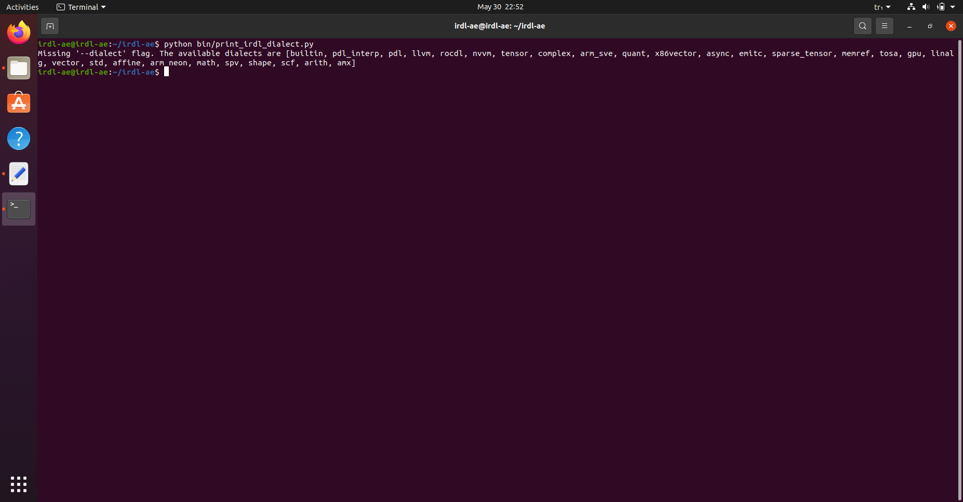
Reproduction of Artifact
Querying the list of available dialects

Slide 12
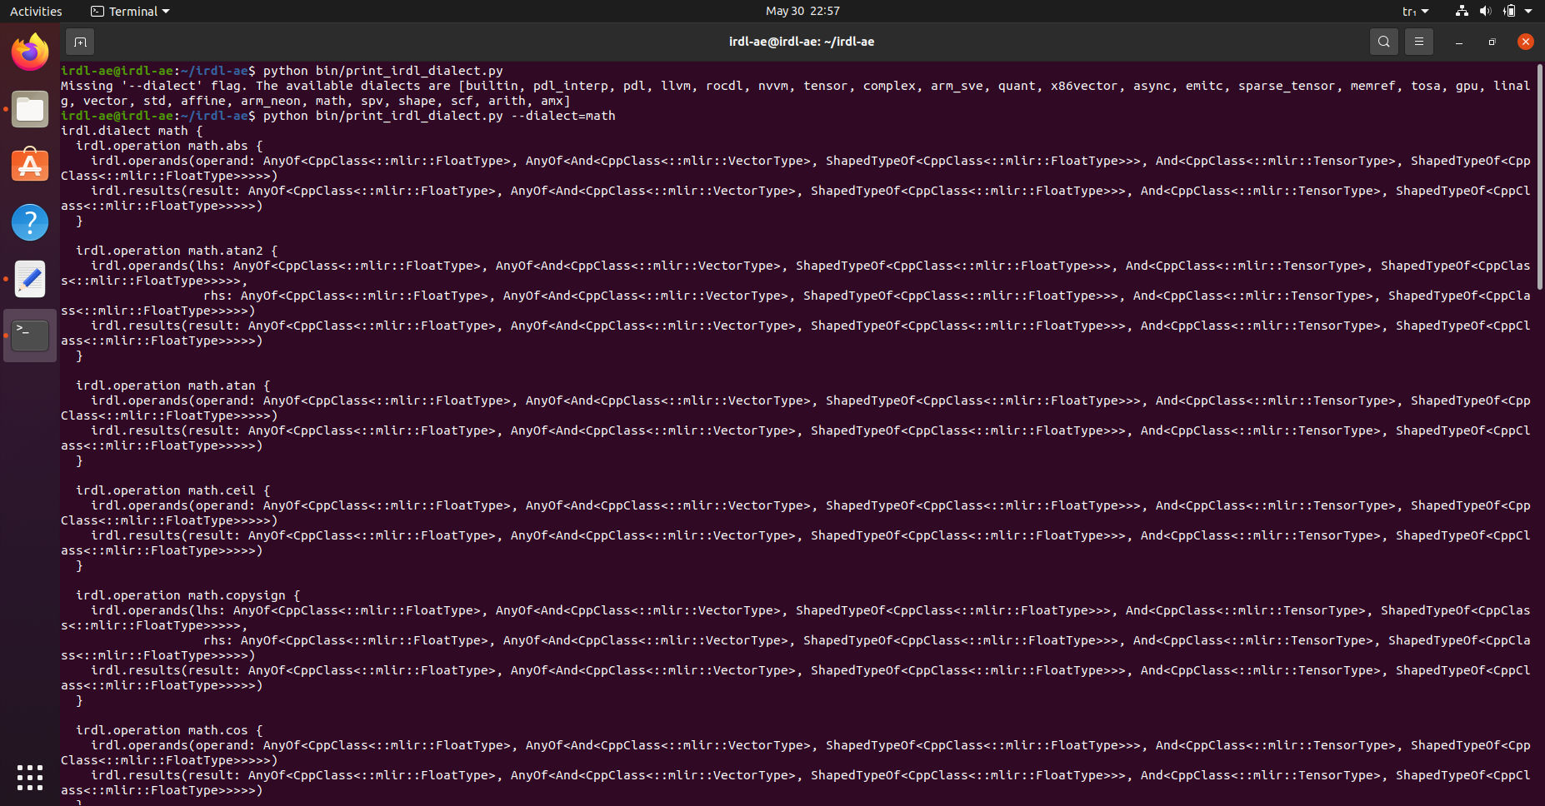
Reproduction of Artifact
Converting math dialect to IRDL format

Slide 13
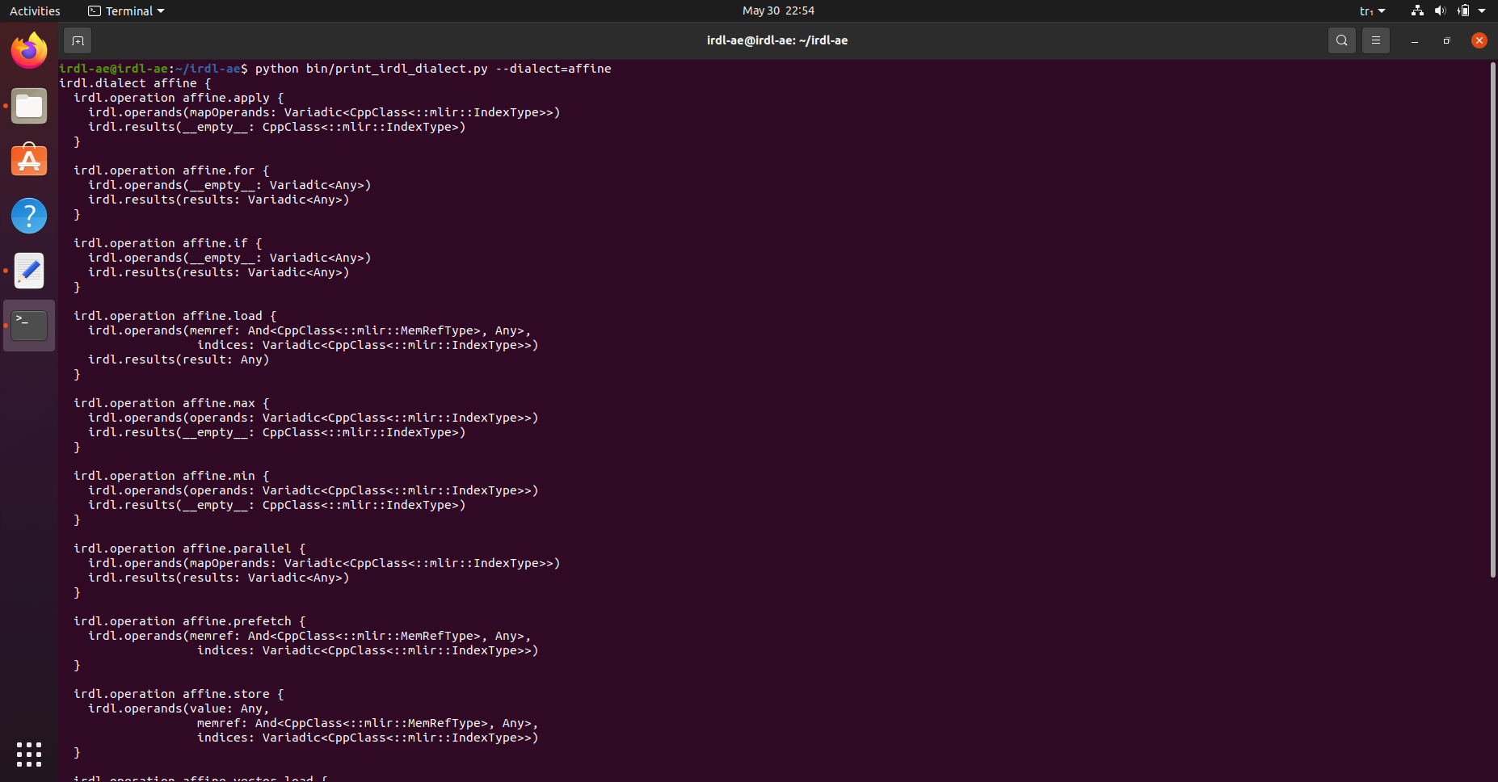
Reproduction of Artifact
Converting math affine dialect to IRDL format

Slide 14
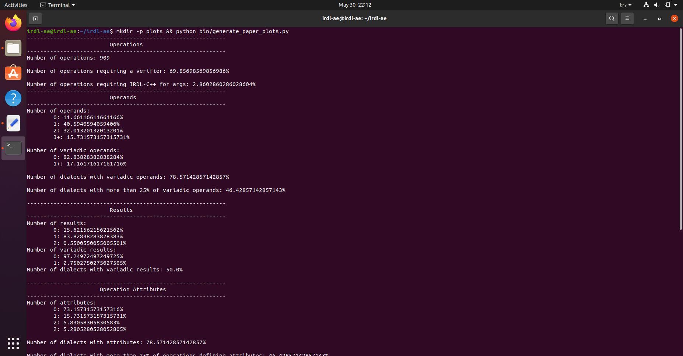
Reproduction of Artifact
Reproduced table statistics for Operations, Operands, Results, Operation Attributes

Slide 15
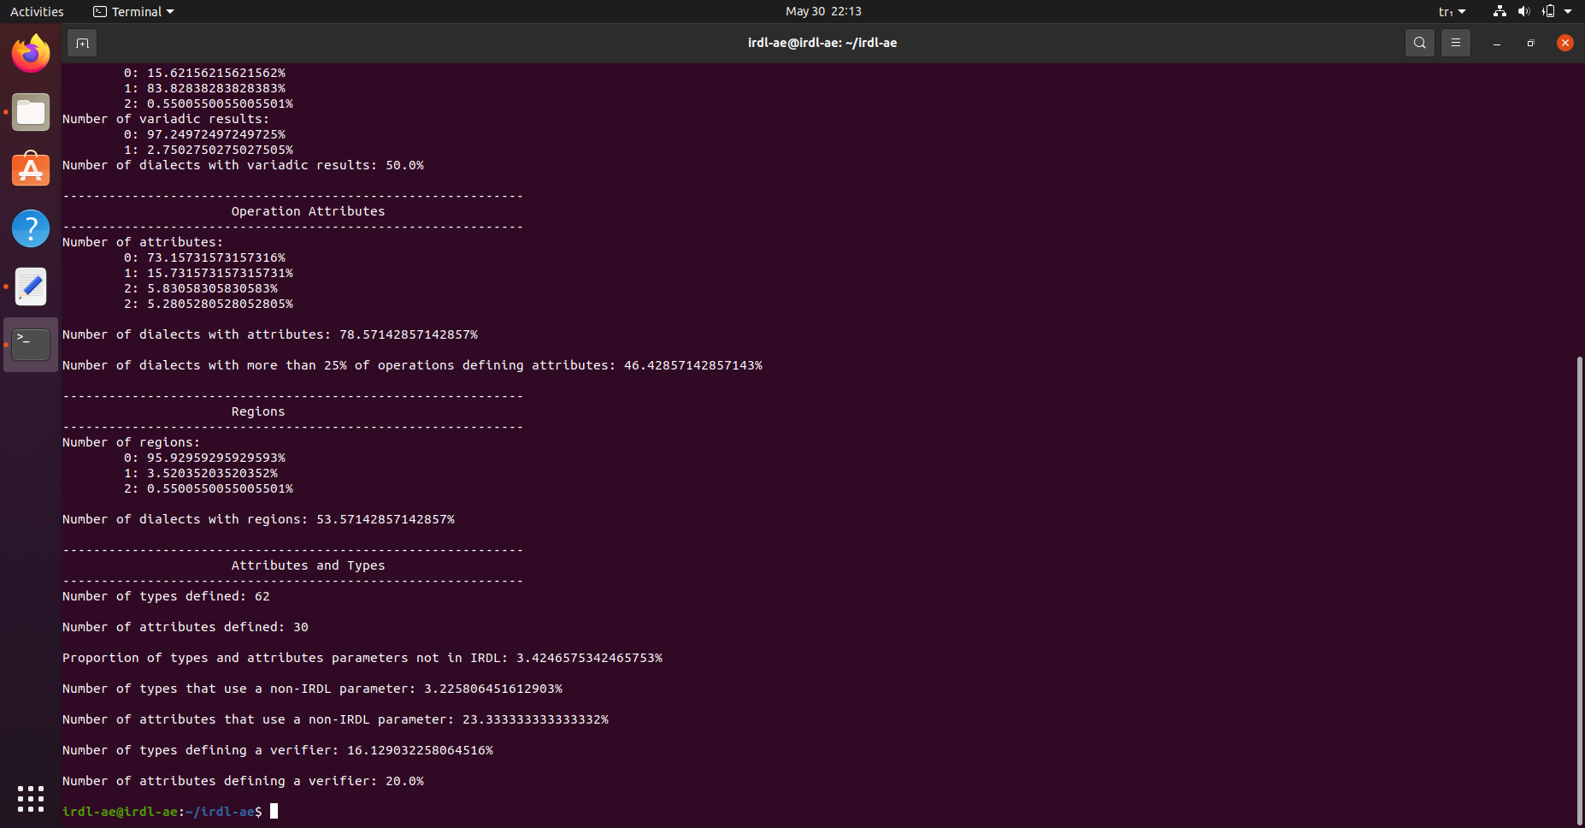
Reproduction of Artifact
Reproduced table statistics for Regions and Number info for Types and Attributes

Slide 16
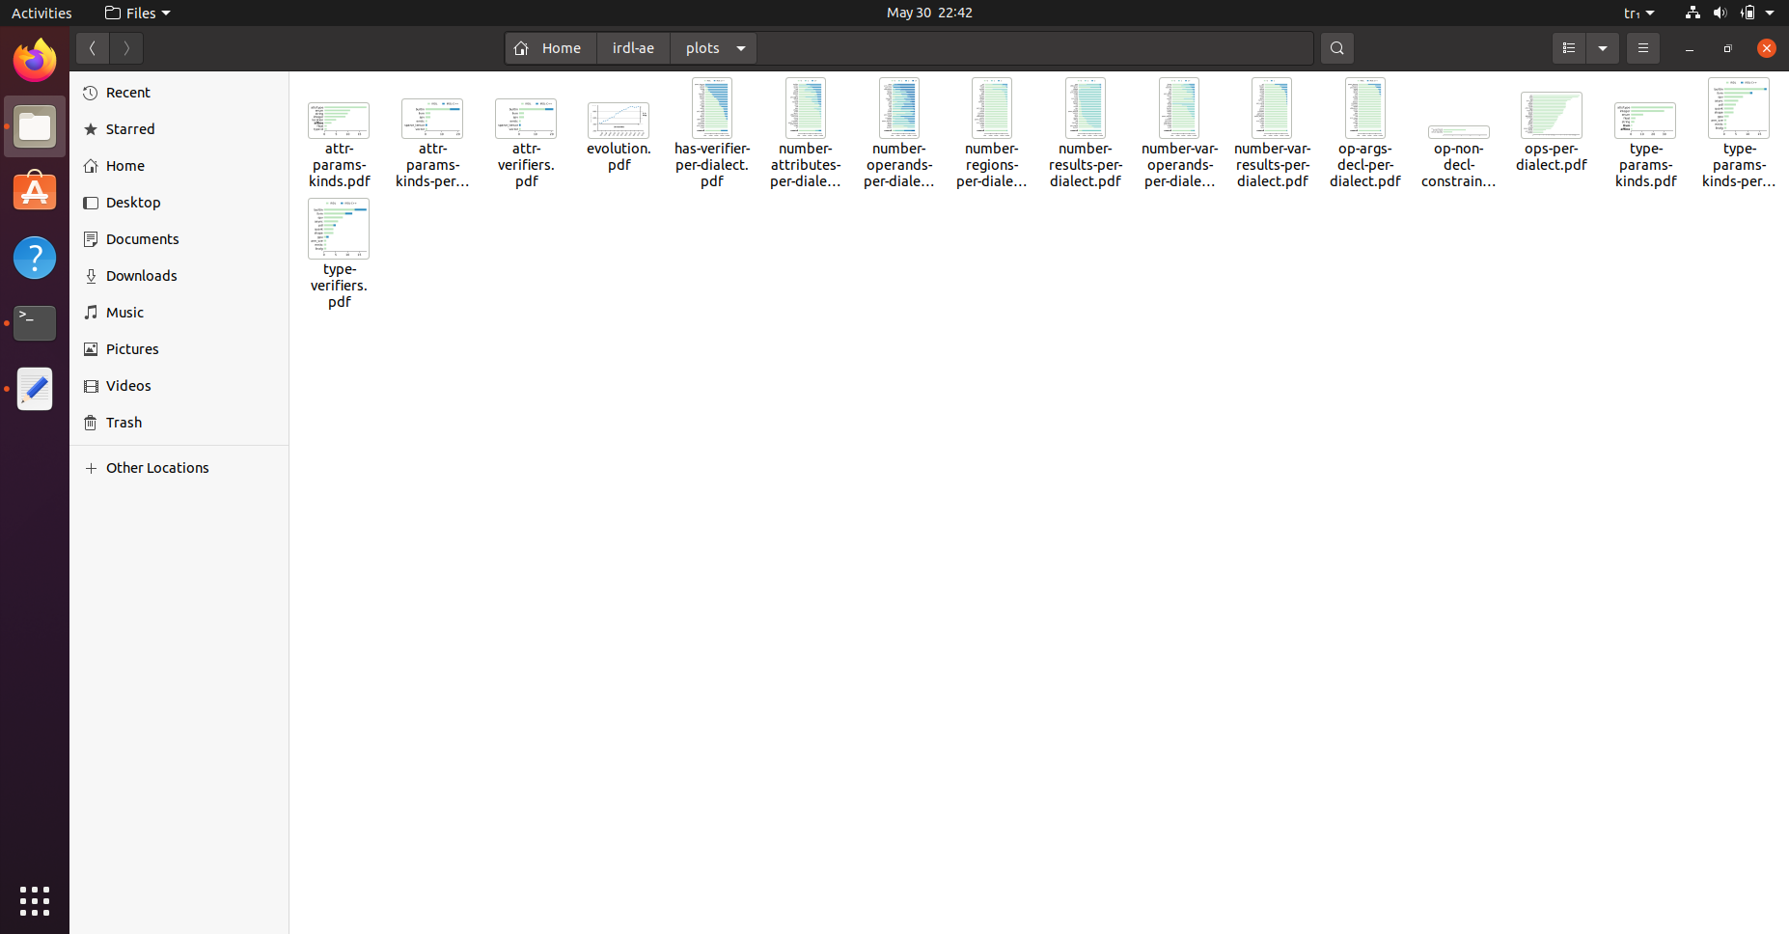
Reproduction of Artifact
Plots are reproduced with command: mkdir -p plots && python bin/generate_paper_plots.py

Slide 17
References
https://www.researchgate.net/profile/Peter-Fritzson/publication/228792639/figure/fig1/AS:393782852898820@1470896556105/Abstract-syntax-tree-of-the-while-loop.png
https://raw.githubusercontent.com/Naios/notepad_llvm/master/preview.png
https://dl.acm.org/doi/pdf/10.1145/3519939.3523700

